Slide 1
Canonical Cover
Notes:
1
The slides for this text are organized into chapters. This lecture covers Chapter 19, on formal, dependency-driven database design..
Integrity constraints, in particular functional dependencies, play an important role in the design of database schemas. In particular, they can shed light on potential redundancies (and the problems that go with redundancy) in a relational schema. Typically, they are used to analyze the relational schema obtained by converting an ER diagram.
This chapter can be covered any time after the Foundations material (Chapters 1 to 5) is covered, at the instructor’s discretion. A good choice is to cover it after presenting all the implementation related material that is included in a course. This will allow a design sequence consisting of Chapters 19 and 20, and will enable the instructor to bring out the fact that design involves both redundancy analysis and performance considerations, and that these concerns should go hand-in-hand.

Slide 2
Canonical Cover Fc
To minimize FDs that need to be tested in case of any update, restrict F to F_{C}
System must rollback updates if FDs are violated
F logically implies all FDs in F_{c} and Vice versa
We can test these violations for simplified set of FDs that has the same closure as the given set

Slide 3
Canonical Cover
Sets of functional dependencies may have redundant dependencies that can be inferred from the others
  For example: A → C is redundant in: {A → B, B → C}
  Parts of a functional dependency may be redundant
    E.g.: on RHS: {A → B, B → C, A → CD} can be simplified to
    {A → B, B → C, A → D}
    E.g.: on LHS: {A → B, B → C, AC → D} can be simplified to
    {A → B, B → C, A → D}
Intuitively, a canonical cover of F is a “minimal” set of functional dependencies equivalent to F, having no redundant dependencies or redundant parts of dependencies

Slide 4
Minimal Set F
F is minimal set of FDs if each X→Y is:
  IYI = 1
  Left reduced (X can’t be replaced by a subset)
  Non redundant (X→Y can’t be removed from F)

Slide 5
Fc
A canonical cover Fc for F is a set of dependencies such that F logically implies all dependencies in Fc, and Fc logically implies all dependencies in F.
The set Fc has two important properties:
  No functional dependency in Fc contains an extraneous attribute.
  Each left side of a functional dependency in Fc is unique. That is, there are no two dependencies a→b and c→d in Fc such that a = c

Slide 6
Equivalence of Sets of FDs
Two sets of FDs F and G are equivalent if:
- every FD in F can be inferred from G, &
- every FD in G can be inferred from F
Hence, F and G are equivalent if F⁺=G⁺
Definition: F covers G if every FD in G can be inferred from F
F and G are equivalent if F covers G and G covers F
There is an algorithm for checking equivalence of sets of FDs

Slide 7
Extraneous Attributes
Attribute is extraneous if we can remove it without changing closure of FDs
Consider a set F of functional dependencies and the functional dependency α → β in F
  Attribute A is extraneous in α if A ∈ α
  and F logically implies (F – {α → β}) ∪ {(α – A) → β}
  Attribute A is extraneous in β if A ∈ β
  and the set of functional dependencies
  (F – {α → β}) ∪ {α →(β – A)} logically implies F
Example: Given F = {A → C, AB → C }
  B is extraneous in AB → C because {A → C, AB → C} logically implies A → C (I.e. the result of dropping B from AB → C)
Example: Given F = {A → C, AB → CD}
  C is extraneous ? D is extraneous? (in AB→CD)

Slide 8
Testing if an Attribute is Extraneous
Consider a set F of functional dependencies over R and the functional dependency α → β in F
To test if attribute A ∈ α is extraneous in α
  compute ({α} – A)⁺ using the dependencies in F
  check that ({α} – A)⁺ contains β; if it does, A is extraneous in α
To test if attribute A ∈ β is extraneous in β
  compute α⁺ using only the dependencies in
  F’ = (F – {α → β}) ∪ {α →(β – A)},
  check that α⁺ contains A; if it does, A is extraneous

Slide 9
Canonical Cover
A canonical cover for F (a set of functional dependencies on a relational schema) is a set F_{C} of dependencies such that F logically
implies all dependencies in F _{C} , and F _{C} logically implies all dependencies in F
The set F _{C} has two important properties
  No functional dependency in F_{C} contains an extraneous attribut
  Each left side of a functional dependency in F_{C} is unique. That
  is, there are no two dependencies α₁ → β₁ and α₂ → β₂ in F_{C} such that α₁ = α₂
Both Fc and F have same closure

Slide 10
Canonical Cover
A canonical cover for F is a set of dependencies F_{c} such that
  F logically implies all dependencies in F_{c,} and
  F_{c} logically implies all dependencies in F, and
  No functional dependency in F_{c} contains an extraneous attribute, and
  Each left side of functional dependency in F_{c} is unique.
To compute a canonical cover for F:
F _{C} = F
repeat
Use the union rule to replace any dependencies in Fc
α₁ → β₁ and α₁ → β₂ with α₁ → β₁ β₂
Find a functional dependency α → β in F _{C} with an
extraneous attribute either in α or in β
/* Note the test for extra. Att. Is done using Fc and not F/
If an extraneous attribute is found, delete it from α → β in F_{C} until (F_{C} does not change)
Note: Union rule may become applicable after some extraneous attributes have been deleted, so it has to be re-applied

Slide 11
Canonical Cover
To minimize the number of functional dependencies that need to be tested in case of an update we may restrict F to a canonical cover F_{c}

Slide 12
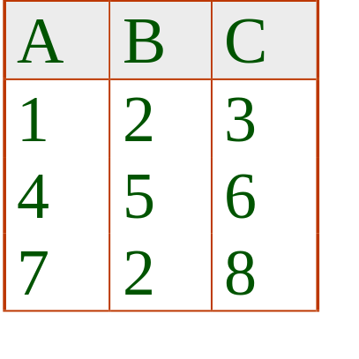
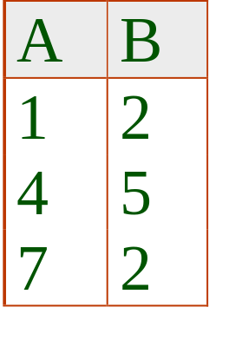

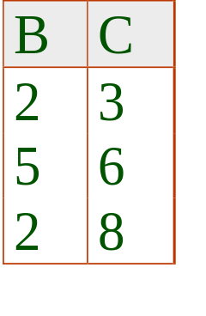
Lossy Decomposition
Note that we can never get anything less than the original relation
Since we don’t know which tuples are spurious and which are genuine, we have indeed lost information
Spurious Tuples
JOIN
Notes:
28

Slide 13
Lossy Decomposition
S# | Status | City
S3 | 30 | Paris
S5 | 30 | Athens
S# | Status
S3 | 30
S5 | 30
S# | City
S3 | Paris
S5 | Athens
1
2
S# | Status
S3 | 30
S5 | 30
Status | City
30 | Paris
30 | Athens
Notes:
28

Slide 14
Lossless Decomposition
Observe that S satisfies the FDs:
  S# ➔ Status & S# ➔ City
It is not a coincidence that S is equal to the join of its projections on {S#, Status} & {S#, City}
Heaths’ Theorem:
Let R{A,B,C} be a relation, where A, B, & C are sets of attributes. If R satisfies A➔B & A➔C, then R is equal to the join of its projections on {A,B} & {A,C}
Observe that in 2 the FD, S# ➔ City is lost
Notes:
28

Slide 15
Lossless Decomposition
The decomposition of R into R1, R2, …Rn is lossless if for any instance r of R
r = ∏_{R1} (r ) ∏_{R2} (r ) …… ∏_{Rn} (r )
We can replace R by R1 & R2, knowing that the instance of R can be recovered from the instances of R1 & R2
We can use FDs to show that decompositions are lossless
Notes:
28

Slide 16
Lossless Decomposition
Theorem
A decomposition of R into R1 and R2 is lossless join wrt FDs F, if and only if at least one of the following dependencies is in F⁺:
  R1 ∩ R2 → R1
  R1 ∩ R2 → R2
In other words, R1 ∩ R2 forms a superkey of either R1 or R2
Notes:
28

Slide 17
Dependency Preservation
Complexity of checking dependency preservation is exponential (subsets)
Decompose directly to dependency preserving decomposition

Slide 18
Dependency Preservation
Let F_{i} be the set of dependencies F ⁺ that include only attributes in R_{i}.
    A decomposition is dependency preserving, if
    (F₁ ∪ F₂ ∪ … ∪ F_{n} )⁺ = F ⁺
    If it is not, then checking updates for violation of functional dependencies may require computing joins, which is expensive

Slide 19
Dependency Preservation
Checking dependency preservation has exponential complexity (Subset calculation, 2^{n} subsets for set of size n)
Better if we could have the decomposition as dependency preserving in the first place (canonical cover F_{c})
F_{c} is the minimal set of FDs equivalent to F⁺
Two sets of FDs G and F are equivalent if G⁺ = F⁺ means G logically implies F and F logically implies G

